Slide 1
Job portal
PRESENTED BY : Mangal D. Yadav
Diploma in c.e
reg.no:S-152807053
6TH SEMESTER

Slide 2
CONTENTS
Introduction
Project Management
System Requirements Study
System Analysis
System Design
Implementation Planning & Details
Testing
User Guide

Slide 3
CONTENTS (CTD…)
Limitation and Future Enhancement
Conclusion & Discussion
Bibliography
Work Experience

Slide 4
INTRODUCTION

Slide 5
INTRODUCTION
We have developed the job-portal. This portal can handle data of Recruits (Several Companies) who are looking for suitable candidates for their vacancies.
This portal will be most useful for Consultants for searching of matching job with jobseekers etc.
A registration form is provided through which user can enter details of company like location of company/type of job/status of job/Qualification of jobseekers.

Slide 6
INTRODUCTION(CTD…)
There is no any online Payment gateway provided in this portal. So, any company which would register would not be able to pay online. Payment would be done by check/case.
There are no banners for advertisement on the site.
This system can run only on Windows platform.
Supported only in My SQL database.
No security of data.
No N-level category.
Supportive language is only English.

Slide 7
INTRODUCTION(CTD…)
TECHNOLOGY AND LITERATURE REVIEW
In developing the Job portal website, we have used ASP.NET 2008. In which C# is used for server side coding. SQL Server is used for as the database. In which .NET framework 3.5 is included. Here are the some features of Asp. Net 3.5 and C# 2.0.
ASP.NET includes:
A page and controls framework
The ASP.NET compiler
Security infrastructure
State-management facilities
Application configuration

Slide 8
DOCUMENT MAP
Web Site Management
New Administration Features and Tools
Reserved Folders for Special Functionality
Recompiling Web Sites for Error Checking and Deployment
Recompiling Web Sites for Error Checking and Deployment
Navigation
Page Design
Pages Consistent Layout using Master
Themes for Consistent Appearance
Themes for Consistent Appearance
User-Customizable Web Pages
User-Specific Values
New Caching Features
Enhanced Client-Side Functionality

Slide 9
DOCUMENT MAP(CTD…)
Controls
General Control Improvements
New Controls
Navigation
Security
Web Parts
Client behavior
Data
Data Source Controls
Middle-Tier Data Access
Data Display Controls
XML Support
Security

Slide 10
DOCUMENT MAP(CTD…)
Data (CTD…)
Connection String Storage
Security
Project Files Created With Web Forms
Deployment
There is two type of Deployment.
Copy your project to the Web server .
Create a deployment project.
Back end
Microsoft SQL Server 2005

Slide 11
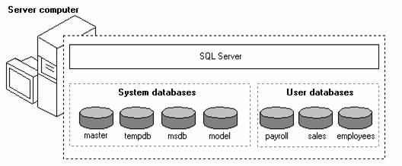
Microsoft SQL Server 2005
SQL SERVER2005

Slide 12
Microsoft SQL Server 2005
Microsoft® SQL Server™ 2005is a set of components that work together to meet the data storage and analysis needs of the largest Web sites and enterprise data processing systems. The topics in SQL Server Architecture describe how the various components work together to manage data effectively.
Microsoft® SQL Server™ 2005data is stored in databases. The data in a database is organized into the logical components visible to users. A database is also physically implemented as two or more files on disk.
Each instance of SQL Server has four system databases (master, model, tempdb, and msdb) and one or more user databases(hmd db, Address Book, payroll, sales, employees). Some organizations have only one user database, containing all the data for their organization. Some organizations have different databases for each group in their organization, and sometimes a database used by a single application. For example, an organization could have one database for sales, one for payroll, one for a document management application, and so on. Sometimes an application uses only one database; other applications may access several databases.

Slide 13
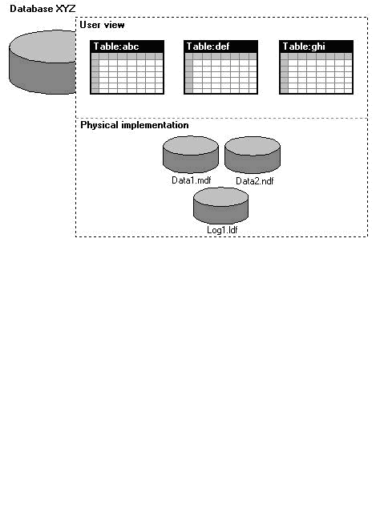
Database Architecture
Database Architecture

Slide 14
Database Architecture
Microsoft® SQL Server™ 2005data is stored in databases. The data in a database is organized into the logical components visible to users. A database is also physically implemented as two or more files on disk.
When using a database, you work primarily with the logical components such as tables, views, procedures, and users. The physical implementation of files is largely transparent. Typically, only the database administrator needs to work with the physical implementations

Slide 15
What's New in Microsoft SQL Server 2005
Microsoft® SQL Server™ 2005 extends the performance, reliability, quality, and ease-of-use of Microsoft SQL Server version 7.0. Microsoft SQL Server 2005 includes several new features that make it an excellent database platform for large-scale online transactional processing (OLTP), data warehousing, and e-commerce applications.
The OLAP Services feature available in SQL Server version 7.0 is now called SQL Server 2005 analysis Services. The term OLAP Services has been replaced with the term Analysis Services. Analysis Services also includes a new data mining component.
The Repository component available in SQL Server version 7.0 is now called Microsoft SQL Server 2005 beta Data Services. References to the component now use the term Meta Data Services. The term repository is used only in reference to the repository engine within Meta Data Services

Slide 16
Features of SQL Server 2005
Microsoft® SQL Server™ 2005 features include:
Internet Integration.
Scalability and Availability.
Enterprise-Level Database Features.
Ease of installation, deployment, and use.
Data warehousing.

Slide 17
Internet Integration
The SQL Server 2005 database engine includes integrated XML support. It also has the scalability, availability, and security features required to operate as the data storage component of the largest Web sites. The SQL Server 2005 programming model is integrated with the Windows DNA architecture for developing Web applications, and SQL Server 2005 supports features such as English Query and the Microsoft Search Service to incorporate user-friendly queries and powerful search capabilities in Web applications.

Slide 18
Scalability and Availability
The same database engine can be used across platforms ranging from laptop computers running Microsoft Windows® 98 through large, multiprocessor servers running Microsoft Windows 2000 Data Center Edition.
SQL Server 2005 Enterprise Edition supports features such as federated servers, indexed views, and large memory support that allow it to scale to the performance levels required by the largest Web sites.

Slide 19
Enterprise-Level Database Features.
The SQL Server 2005 relational database engine supports the features required to support demanding data processing environments. The database engine protects data integrity while minimizing the overhead of managing thousands of users concurrently modifying the database. SQL Server 2005 distributed queries allow you to reference data from multiple sources as if it were a part of a SQL Server 2005 database, while at the same time, the distributed transaction support protects the integrity of any updates of the distributed data. Replication allows you to also maintain multiple copies of data, while ensuring that the separate copies remain synchronized. You can replicate a set of data to multiple, mobile, disconnected users, have them work autonomously, and then merge their modifications back to the publisher.

Slide 20
Ease of installation, deployment, and use
SQL Server 2005 includes a set of administrative and development tools that improve upon the process of installing, deploying, managing, and using SQL Server across several sites. SQL Server 2005 also supports a standards-based programming model integrated with the Windows DNA, making the use of SQL Server databases and data warehouses a seamless part of building powerful and scalable systems. These features allow you to rapidly deliver SQL Server applications that customers can implement with a minimum of installation and administrative overhead.

Slide 21
Data warehousing
SQL Server 2005 includes tools for extracting and analyzing summary data for online analytical processing. SQL Server also includes tools for visually designing databases and analyzing data using English.

Slide 22
Project Management

Slide 23
Project Management
Project Planning and Scheduling
Project planning establishes a plan for the software engineering work that follows. It describes the technical tasks to be conducted, the risks that are likely, the resources that will be required, the work product to be produces, and a work schedule.
Project scheduling is an activity that distributes estimated effort across the planned project duration by allocating the effort to specific software engineering tasks. It is important to note, however, that the schedule evolves overtime. During early stages of project planning, a macroscopic schedule is developed. This type of schedule identifies all software framework activities and the product functions to which they are applied. As the project gets under way, each entry on the macroscopic schedule is refined into a detailed schedule. Here, specific software tasks ( required to accomplish an activity) are identified and scheduled.

Slide 24
Project Development Approach
To solve actual problems in an industry setting, software engineer or a team of engineers must incorporate a development strategy that encompasses the process, methods and tools layers and generic phase. This strategy is often referred to as process model or a software engineering paradigm. A process model for software engineering is often chosen based on the nature of the project and application, the methods and tools to be used, and the controls and deliverables that required.
To solve actual problems in an industry setting, a software engineer or a team of engineers must incorporate a development strategy that encompass the process, methods, and tool layers.

Slide 25
Project Development Approach(CTD…)
Types of Software Process Models:
The Linear sequential Model ( Waterfall Model)
The Prototyping Model
The Rapid Application Development (RAD) Model
The Incremental Model
The Spiral Model
The WINWIN Spiral Model
The Concurrent Development Model
The Formal Methods Model
The Component Based Developed Model
Fourth generation Technique ( 4GT )
Agile Software Model
Note:- Our software is based on Linear sequential Model ( Waterfall Model)

Slide 26
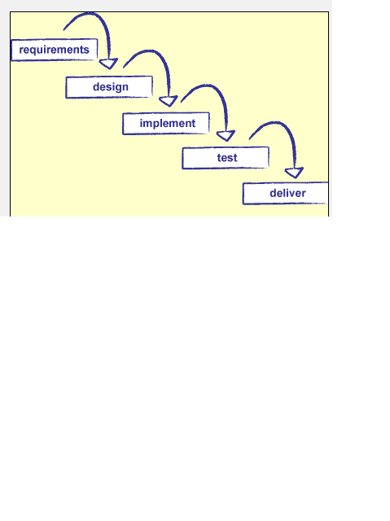
Linear sequential Model ( Waterfall Model)
WATER FALL DIAGRAM

Slide 27
( Waterfall Model)
Requirement:-
In the requirement phase the need to create the application is specified. What is the need of the system is defined. What information to be feeder to create the application will come under the requirement phase?
Design:
After the requirement phase the next phase is the Design phase where the application is designed according to the forms and other modules created. This phase is much important phase because it will structure the layout of your application.
Implementation:
Implementation is the process of having a system personnel phase check out and put new equipment into use, train users, install new application and construct any file of data need to use it.
Verification:
After the whole application is being the developed the main phase is the verification phase where the whole application tested and verified to check the whole application.
Maintenance:
After the successful verification of the application the main phase is the maintenance phase where the application needs to be maintained for its successful operation in future.

Slide 28
Disadvantages:
It is difficult for the customers to state the requirements clearly at the beginning. There is always certain degree of natural uncertainty at beginning of each project.
Difficult and costlier to change when the changes occur at later stages.
Customer can see the working version only at the end. Thus any changes suggested here are not only difficult to incorporate but also expensive. This may result in disaster if any undetected problems are precipitated to this stage

Slide 29
System Requirements Study

Slide 30
User Characteristics:
End User
Every user should be comfortable of working with computer and net browsing.
He must have basic knowledge of English too.
He has must be some knowledge of how to use any websites.
Administrator
Administrator is an entity that will manage entire system. He/she will have highest level of access rights and he will be provided with his own interface to access powerful features. An administrator can cover areas such as database, security and integration.
He can view, modify or delete records. He can do all kind of alterations in the database.

Slide 31
Hardware and software Requirements
Minimal Hardware Requirements:
Intel Pentium 4.1GHz processor
512MB SDRAM
5GB Hard disk space
Internet Connection
Key Board
Mouse
Minimal Software Requirements:
Windows XP/Server 2003
Microsoft Visual Studio 2008
Microsoft .NET Framework v3.5
SQL server 2005
Microsoft Office 2007
IIS

Slide 32
System Analysis

Slide 33
System Analysis
Study of current System:
This application having database which is a repository of an organization’s electronically stored data. The databases are designed to facilitate analysis.
The classic Functionality of this Application focuses on data storage. However, the means to retrieve and analyze data, to extract, transform and load data, and to manage the data dictionary.
Functional Components of the project:
To facilitate easy maintenance of records of various Recruiters (Companies), job and job seekers.
To check for details prospective jobseekers through quick search provided in the portal.
To check for matching job with jobseekers.
Quick access of all record.
To match the suitable candidates to appropriate job.
Prevent and reduce human error.
Reduce manual work.

Slide 34
System Analysis(CTD….)
The new system that was to be built in the organization need to have some creative concept that can help the user in the real manner and the next important thing is that it should give the cost effective solution to the user. Due to the collaborative nature of the application the user can really be an important part of it rather than just using it blindly. As the prior applications were not providing the user portability, the new application should be created for manage jobseekers and employers (recruiters) so that user can access the application at any of the corner in the world into his/her hand only. The new application also gives the user the liberty to know and use the application from the web through the web modules which gives complete information of the application.

Slide 35
System Analysis(CTD….)
Feasibility Study
The main purpose of feasibility analysis is to check the economic viability of the proposed system. The result of the feasibility study will indicate whether to proceed with the proposed system or not. If the results of the feasibility study are positive, then we can proceed to develop a system otherwise project should not be pursued.
Technical Feasibility
This system will be developed using Asp.net. As we require some time to learn all these technologies, All these technologies are easy to learn and can develop system very rapidly. After developing and deploying the system, any user can view this site on the Internet.
Economical Feasibility
Proposed System requires development tools and software such as visual studio 2008 which are free of cost and available on internet. For developing proposed system, we need various resources such as computers systems, internet connection for e-help, recommended disk space, and memory speed as mention in technical requirement. By looking at all these expenses and comparing with proposed system, we have many benefits from proposed system such are
As existing system is manual, where data may not accurate, up to date, and available on time. But proposed system will be computerized, so we can overcome all limitations of existing system. Also with this new system insertion, deletion, and modification of various data will be easier to handle.
This system will reduce the paperwork. And quality of data will be improved.

Slide 36
System Analysis(CTD….)
Operational feasibility
Users of the system will the registered user of the website.
To put an orders user should have only basic knowledge of computer and Internet which is not a big issue.
Basic training is required for other users to handle and manage the information.
Requirement Validation
Username and Password validation that is compulsory to enter within system (Not for visitor).
The user must have the email id in Gmail, yahoo or any website.
Phone No must be Numeric and length is of maximum 11 Digit.
Name must be character not in digit.
Pin code No. is of 6 digits.
For every new entry of enter all data manually, made entry by adjustment form. So it reduces mismatch in data.
The field denoted by (*) are compulsory.
Most of the data are enter from the master table so it also reduces the chances of mismatch data.

Slide 37
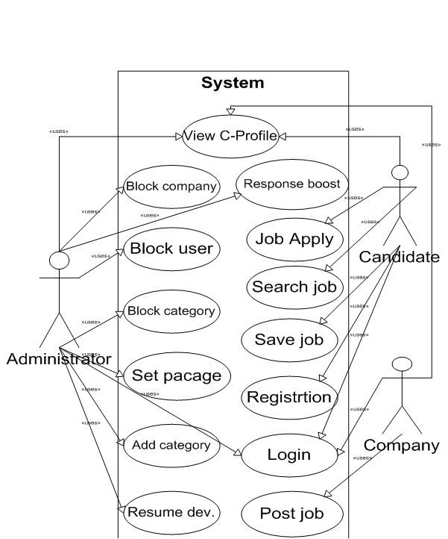
System Analysis(CTD….)
USE CASE DIAGRAM

Slide 38
System Analysis(CTD….)
Data Dictionary
A Data Dictionary is simply a record of data about data. It may be manually compiled or it may be a fully automated package. All definitions of elements in the system – data flows, processes, and data stores – are stored in Data Dictionary.
Data Dictionary is an integral component of structured analysis. Data Dictionary provides additional information about the system.
A Data Dictionary is a catalog- a repository --- of the elements in a system. These elements center on data and the way they are structured to meet user requirements and organization needs. The major elements are data flows, data stores and processes. The data Dictionary stores details and descriptions of these elements
The Data Dictionary is the only common source of definitions for users and investigators alive. It is the single source of answer of answers to all questions regarding the format and context of the data sets used in the system.
Data Elements
The most fundamental level of data is the data element. Data elements are building blocks for all other data in the system like Data Names, Data Description, Aliases, Length, and Data Values.
Data structures
The Data Structure is a set of data items that are related to one another and that collectively describe a component in the system.

Slide 39
DATABASE DESIGN
Database Tables’ Names and Description
Table Name | Table Description
Login | Login Details
Candidate | Basic information about Candidates
Candidate education | Educational details about the candidate
Cadidate_Professonal | Professional details about the candidate
Candidate_addrs | Address about Candidate
Company | Company details
Company_Branch_add | Branch details of company

Slide 40
DATABASE DESIGN
Table Name | Table Description
Package | Package decided by admin
Company_package | Packages held by companies
Job_Applied | Applied jobs by candidates
Job_post | Posted jobs
Post | Post (designation)
Questions | Security questions
Resume | Resumes of candidates

Slide 41
System Design

Slide 42
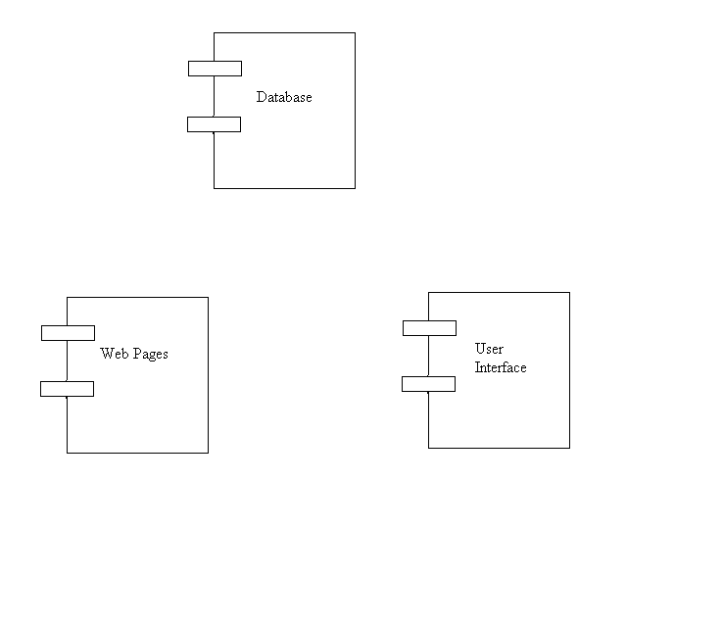
Component Diagram

Slide 43
Component Diagram
The component diagram contains components and dependencies. Components represent the physical packaging of a module of code. The dependencies between the components show how changes made to one component may affect the other components in the system.
Dependencies in a component diagram are represented by a dashed line between two or more components. Component diagrams can also show the interfaces used by the components to communicate to each other.

Slide 44
SYSTEM ARCHITECTURAL DESIGN
Fundamental design Concepts
A set of fundamental design concepts are evolved over the past three decades. Although the degree of interest in each concept has varied over the years, each has stood the test of time. Each provides the software designer with a foundation from which more sophisticated design methods can be applied. Fundamental design concepts provide the necessary framework for “getting it right”.
Abstraction
Abstraction permits one to concentrate on a problem at some level of generalization without regard to irrelevant low level details, use of abstraction also permits one to work with concepts and terms that are familiar in the problem environment without having to transform them to an unfamiliar structure. Two types of abstraction are there, one is procedural abstraction and data abstraction. A procedural abstraction is a named sequence of instructions that has a specific and limited function. A data abstraction is a named collection of data that describes a data object.
Modularity
Modularity is the single attribute software that allows a program to be intellectually manageable. Software architecture embodies modularity, that is, software is divided into named and addressable components, called modules that are integrated to satisfy problem requirements.

Slide 45
SYSTEM ARCHITECTURAL DESIGN (CTD…)
Software Architecture
Software Architecture alludes to “the overall structure of the software and the ways in which that structure provides conceptual integrity for a system”. Control hierarchy also called program structure”, represents the organization of control. The tree structure used to represent the control hierarchy.
Structural Partitioning
The program structure should be partitioned both horizontally and vertically. Horizontal partitioning defines separate branches of the modular hierarchy for each major program function, Vertical partitioning called factoring, suggest that control and work should be distributes top-down in the program architecture. Top level modules should perform control functions and do little actual processing work. Modules reside low in the architecture should be the workers, performing all input, computational, an output tasks.
Data Structure
Data Structure is a representation of logical relationship among individual elements of data. Because the structure of information will invariably affects the final procedural design, data structure is very important as the program structure to the representation of the software architecture. Data structure dictates the organization, methods of access, degree of associatively, and processing alternatives for information. The organization and complexity of a data structure are limited only by the ingenuity of the designer. Scalar item array and linked list are some of the representations of the data structure.

Slide 46
Implementation Planning & Details

Slide 47
Implementation Environment
Factors Considered
Before developing a internet or intranet website, it is a worthwhile to explore the differences between the two, as well as the issues related to developing the internet and intranet websites. The next two sections, “Internet website development” and “Intranet website development” discuss internet and intranet web development as they related to the following topics:
Bandwidth availability
One major difference between internet and intranet websites is bandwidth available to users browsing the websites. Most internet users are connected to the internet via relatively slow POTS ( Plain Old Telephone Service ) modem links. Information published on an internet websites should deoptimized for transmittal over low bandwidth internet connections.
Server Latency:
Server latency must be addressed when deploying a website on the internet. Web servers are no longer used exclusively to publish static content on the internet. Increasingly, web servers are using server side applications to create dynamic content. Although a 486DX2/66 computer can saturate a T1 connection with static

Slide 48
Implementation Environment (CTD….)
SCOPE OF NETWORK:
Taking to account, the scope of your network when setting up your web server. Confidential information that should remain only within your organization should not be published from a server that accessible via internet.
Platform Compatibility:-
The internet’s consist of a wide variety of hardware platforms and operating systems. When publishing information, platform compatibility should be taken into a account to ensure that information published at your web site is accessible to a wide variety of users. When users need to use a special helper application to view a file at your website, provide URLs for downloading helper application that run on several platforms. At minimum, windows and Macintosh users should be able to view information publish at your website as should those who use widely used flavors of UNIX.
Security:-
While an internet web site is accessible primarily to select individuals, an internet web site is accessible to millions of users all over the world. Never use clear text passwords to protect sensitive information distributed to and from an internet websites. When distributing sensitive information via the internet, configure your website to encrypt the data. See chapter 20 , “Security” , of volume 2 of this kit(Windows NT internet and intranet administration) for more information about internet security encryption.

Slide 49
Implementation Environment (CTD….)
Secure Encryption Keys and Hashing
It is highly recommended that you encrypt user passwords in the membership data source using a password Format attribute set to Hashed or Encrypted, where Hashed is the most secured format. The encryption key values for the specified encryption algorithm are stored in the machine key configuration element. For strong encryption, specify an encryption key and specify the IsolateApps option with key.
Securing Connections to a membership Data Source
Connection Strings
To keep the connection to your database server secure, you should encrypt connection-string information in the configuration using Protected Configuration.
Connecting to SQL server using Integrated Security
You should connect to computers running SQL server using integrated security to avoid the possibility of your connection string being compromised and your user id and password being exposed. When you specify a connection that uses Integrated Security to connect to a computer running SQL server, the membership feature reverts to the identity of the process. You should ensure that the identity of the process running ASP.NET ( for example , the application pool) is the default process account or a restricted user account.

Slide 50
Testing

Slide 51
Testing
Testability:-
Software Testability is simply how easily a computer program can be tasted. The check list that follows provides a set of characteristics that lead to testable software.
Operability
Observables
Controllability
Decomposability
Simplicity
Stability
Understandability
Following are the attributes of the Good Test
A good test has a high probability of finding an error.
A good test is not redundant.
A good test should be “Best of Breed”.
A good test would be neither too simple nor too complex.

Slide 52
Testing(CTD….)
Compartmentalization:-
In this step we divide the project into number of manageable activities and task like
Selection Module
System Admin data module
Dept. Admin data module
Store and assign rendered module
Employee data module
Task creation data module
Task allocation and reply data module
Insert category and pwd Authority module
Testing Module
Documentation Module

Slide 53
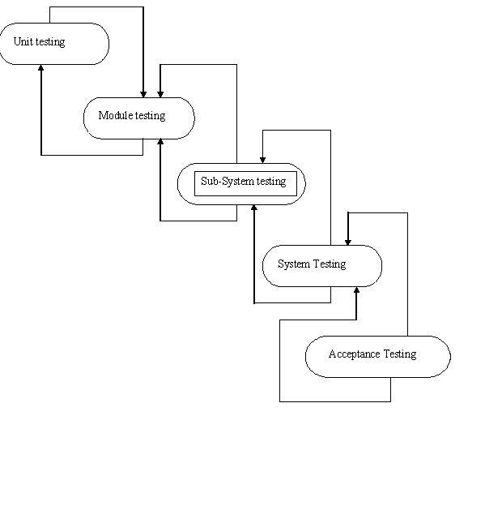
Figure of Testing Process

Slide 54
Testing Plan
THE TESTING PROCESS
Developer tests the software process activity such as design, implementation and the requirement engineering. Because, design errors are very costly to repair when the system has been started to operate. Therefore, it is quite obvious to repair them at early stage of the system. So, analysis is the most important process of any project.

Slide 55
Testing Plan
TESTED ITEMS
Our tested items are like:
Data fetching from the database
Data insertion, updating and deleting in the database
Form access to particular login

Slide 56
User Guide

Slide 57
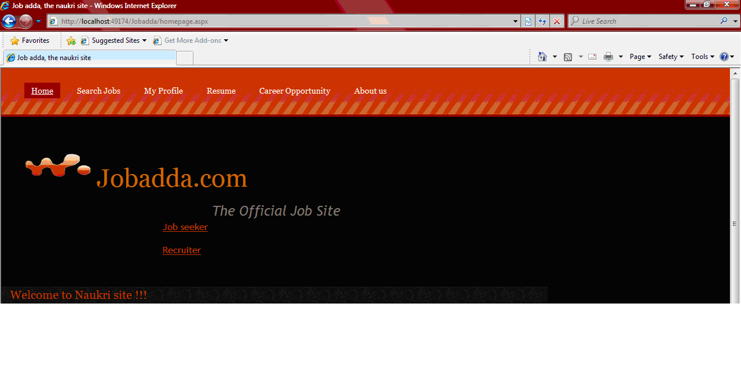
User guide(CTD….)
Home page

Slide 58
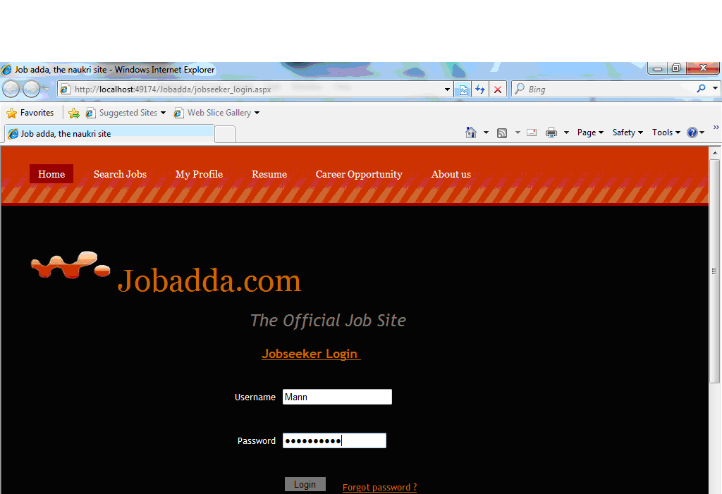
User guide(CTD….)

Slide 59
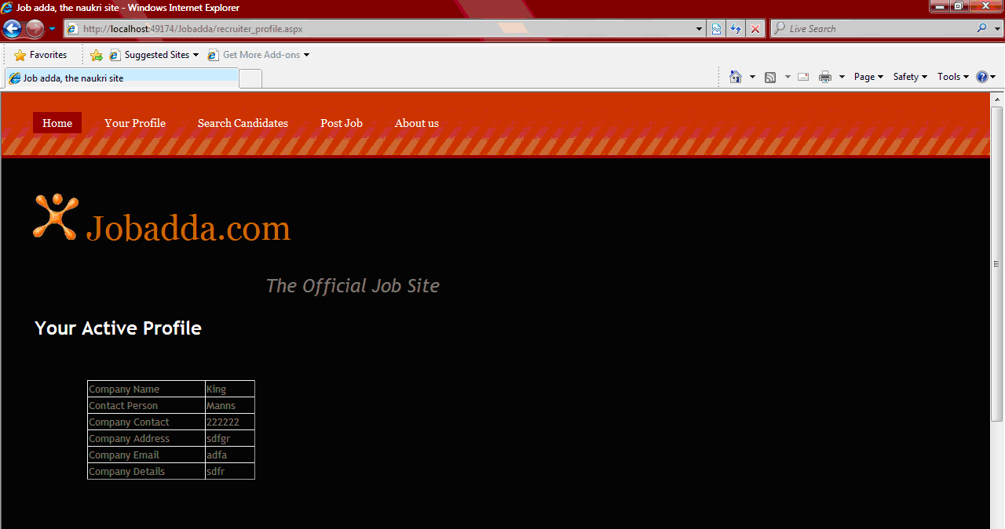
User guide(CTD….)
Your Active profile

Slide 60
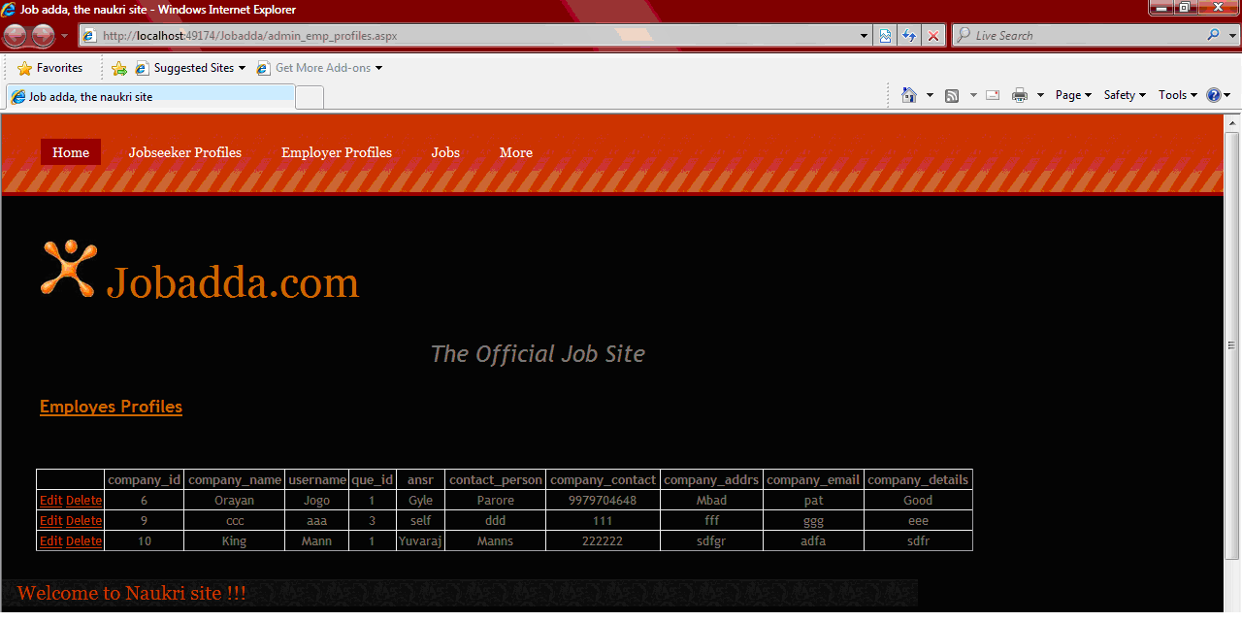
User guide(CTD….)
Employers Profile

Slide 61
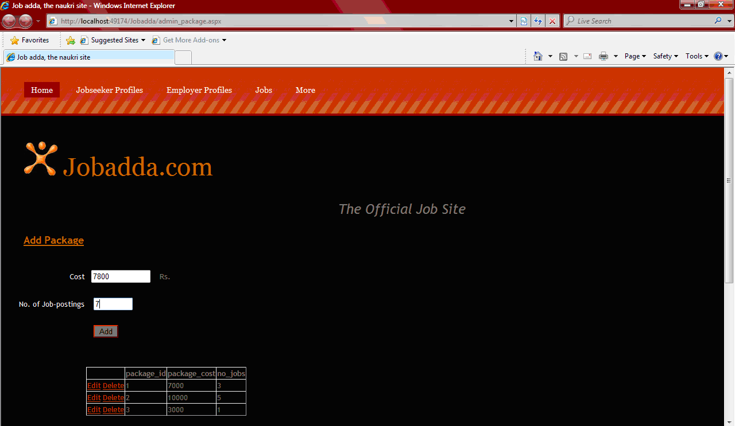
User guide(CTD….)
Add Package

Slide 62
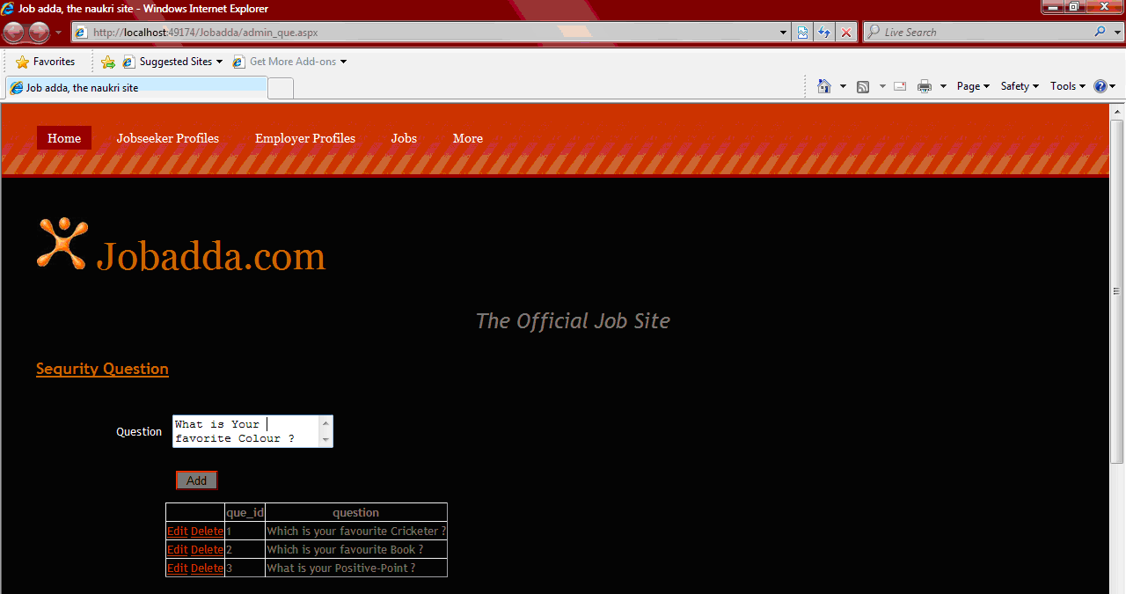
User guide(CTD….)
Security Questions

Slide 63
User guide(CTD….)

Slide 64
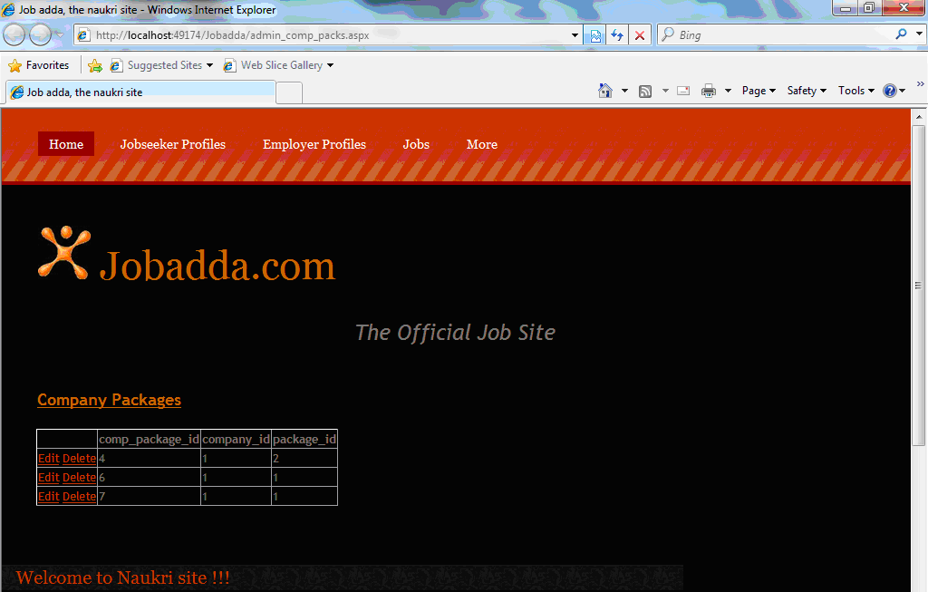
User guide(CTD….)
Company Package

Slide 65
Limitation and Future

Slide 66
Limitation and Future
Limitations
It can run only on windows servers. It is not compatible with LINUX servers.
It is not cent percent safe from professional hackers.
Only registered user can buy and sell their items using this website.
Future enhancements
In future if we get a chance to work on the same project then we like to implement
Improvement for advertisement.

Slide 67
Conclusion & Discussion

Slide 68
CONCLUSION & DISCUSSION
CONCLUSION:
In making of this application, we have learnt that handling files and maps is becoming easy.
Using this application, a user gets a different information and a cost effective solution by visiting unknown place efficiently with all the necessary information regarding to various hotspots the user visits.
DISCUSSION:
This application is made for all the users so that user can see the required information at the website also in his/her own hand. So, the main goal of portability and mobility gets achieved by this application.
Further, this application is made using Asp.net and c# which is leading Microsoft application programming technology. Hence, this application is also economic solution for the user.
Now, this is a user friendly website so, any user can use this website to buy and sell different products. Therefore, this application provides collaborative interface to the users.

Slide 69
BIBLIOGRAPHY

Slide 70
BIBLIOGRAPHY
References Books
C# 2.0 Complete Reference
ProfessionalASP.NET 2.0
ASP.NET in 21 days
ASP.NET Complete Reference
MSDN 2005
System Analysis And Design

Slide 71
BIBLIOGRAPHY(CTD…)
Internet Sources:
Naukari.com
Monster.com
Shine.com
www.thejobs4u.com

Slide 72
THANK YOU

